Slide 1



Paper Waste in Institutions
Ameena Kousar- VII Std
Hamsika - VII std

Slide 2
Introduction
India, being progressive in literacy rate, shows and ever increasing demand for paper.
It has been estimated that the demand for paper in the country by 2025 would be close to 2.5 crore metric tons.
This is a difficult task to achieve for the Indian paper industry. On one side, we have to deal with deforestation and pollution and on the other hand we have to ensure that the demand for paper is met.
In India 3 million tonnes of waste paper are recycled every year but this makes only up to 20% of the total waste.

Slide 3
The uncollected paper waste causes equal damage to the environment as like that of plastic.
The following are some of the problems caused by paper waste accumulation
Deforestation - About 10,000 A4 sized sheets of paper coasts a tree of 45ft of the usable trunk and a diameter of eight inches. The tonnes of paper waste every year destroys thousands of trees.
Landfill volume – Nearly 10-11 million tonnes of paper ends up in landfill each year
Litter- paper waste littering in an area makes the area unattractive

Slide 4
Economic loss- Faulty prints, wrong contents, mistakes, extra supply all will lead to waste of money
Why should we save paper and reduce waste
Recycling one tonne of waste paper can help in about 70% raw material saving along with coal saving of 60%, energy 43% and water 70% which are used in the making of paper from wood.

Slide 5
OBJECTIVES
To understand how students can contribute in saving environment by altering certain habits
To cooperate with the school in reducing the waste from classrooms.
To learn more about how paper waste reduction can help environment
This project was taken up as a part of our school eco club assignment.

Slide 6
Method and materials used
Went everyday to classrooms , checked the paper waste in dustbins and wrote down the findings.
Requested ayahs to keep the waste from each floor together so that we could check the weight
First one week, we observed the quantity of the waste generated and then conducted an awareness campaign.
Checked the overall weight of the dustbin bag in which classroom waste was collected and kept.
Used Spring scale to measure the paper waste collected by helper staff in our school. Maintained a manual record.

Slide 7
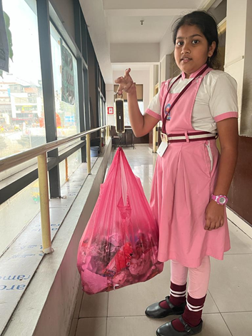
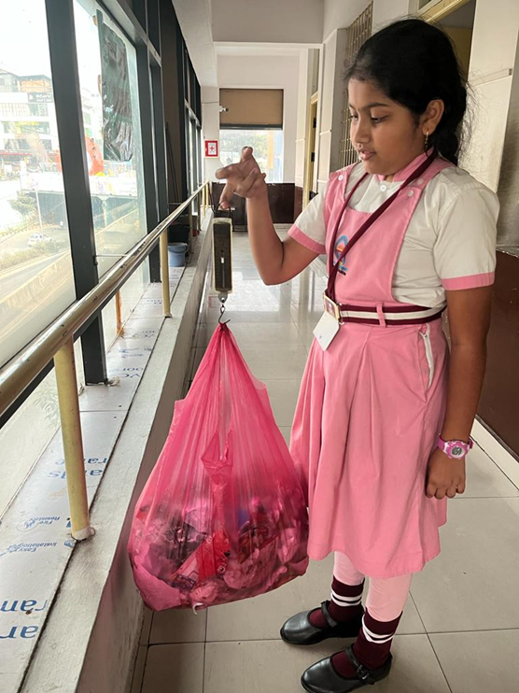
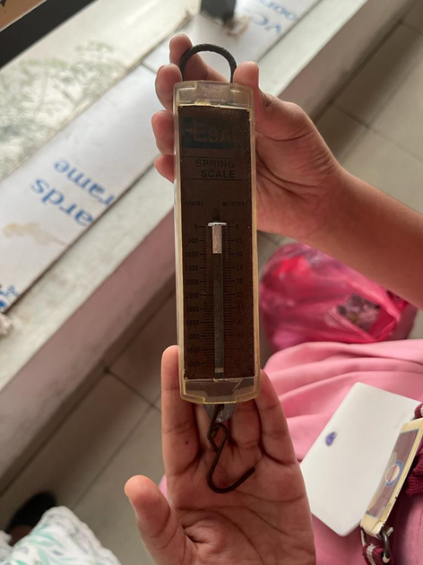

Slide 8
CLASSWISE PAPER WASTE GENERATION
CLASS | DAY 1 | DAY2 | DAY3 | DAY4 | DAY5
1 | MORE | COMPARATIVELY LESS | SAME AS DAY 2 | SAME AS DAY 1 | SAME AS DAY 2
2 | LESS | LESS | LESS | LESS | LESS
3 | MORE | LESSER | LESSER | LESSER | LESSER
4 | MORE | MORE | MORE | MORE | MORE
5
6 | AVERAGE | AVERAGE | AVERAGE | AVERAGE | AVERAGE
7 | LESS | LESS | LESS | LESS | LESS

Slide 9
CLASS | DAY 1 | DAY2 | DAY3 | DAY4 | DAY5
8 | AVERAGE | LESS | LESS | LESS | LESS
9 | AVERAGE | AVERAGE | MORE | LESSER | LESSER
10 | MORE (PAPERS OUT OF THE DUSTBIN) | MORE | AVERAGE | AVERAGE | LESSER
TOTAL PAPER WASTE GENERATED / DAY BEFORE AWARENESS CAMPAIGN
DAY 1 | DAY 2 | DAY3 | DAY 4 | DAY 5 | AVERAGE
400g | 1200g | 1500g | 1400g | 800g | 1060 g (1 Kg)

Slide 10
Method of waste disposal
The school gives off the dry waste to the BBMP pourakarmikas weekly once.
On an average, per week, nearly 5 Kg paper waste will be produced. If working days are calculated as 210 days in the school, annually, 150Kg paper waste is generated from our school alone. (210 days/ 7 = 30 weeks = 30 x 5 = 150 Kg)

Slide 11
Estimated waste generation by schools on an average
A search in Google showed that there are 1391 schools including primary and High schools in Bangalore. Considering a minimum of at least 2 Kg waste per week per school, annual production will be 1391 x 2 x 30 = 83460 Kg
Any paper that is stained with food or cooking oil is not recyclable . Since most of the paper waste in classrooms might contain one or the other stain, we doubt these papers will go for recycling. So, these wastes might end up in land fills.

Slide 12
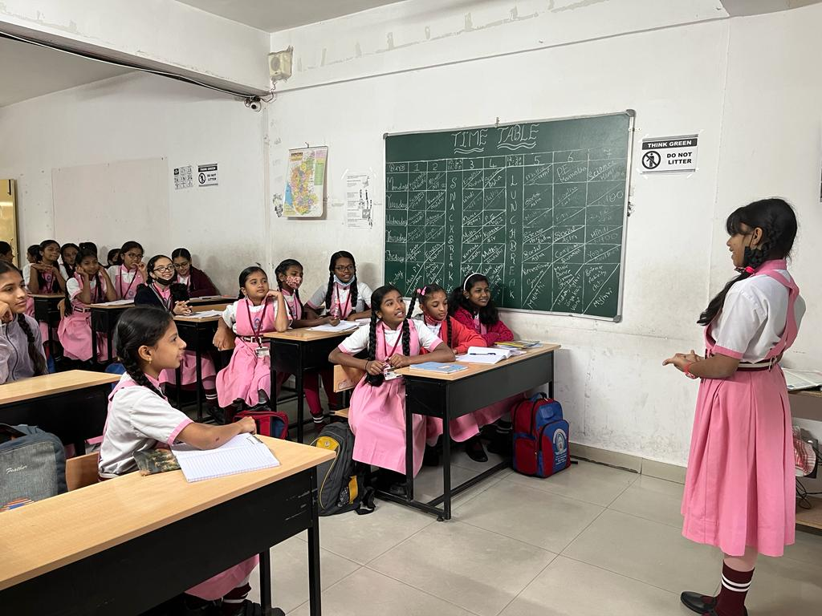
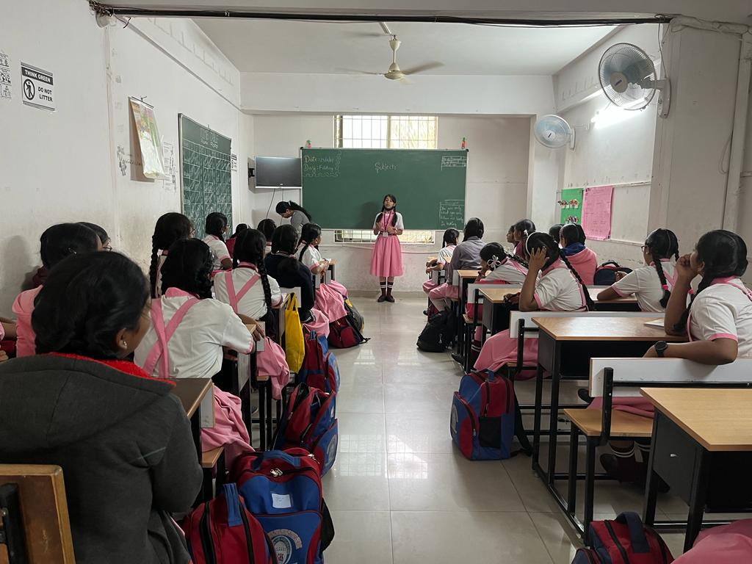
Conducted Awareness campaign in the school going from class to class

Slide 13
Requested students the following during the awareness campaign
Not to tear paper unnecessarily
To put the waste paper in a separate bin kept in corridor so that the papers do not mix with food waste.
Requested ayahs not to mix the paper waste with classroom waste so that they can hand over the papers separately for recycling.

Slide 14
TOTAL PAPER WASTE GENERATED / DAY AFTER AWARENESS CAMPAIGN
DAY 1 | DAY 2 | DAY3 | DAY 4 | DAY 5 | AVERAGE
450g | 900g | 700g | 1000g | 550g | 3600g (3.6 Kg)
Difference on an average in waste produced- 1700 g (1.7 Kg)
Observation
Despite the awareness campaign, some classes (especially IV std and X std) continue to produce almost the same amount of waste. This was seen more in higher classes.
In some lower classes, where the class teachers are strict, there were very less amount of paper waste.

Slide 15
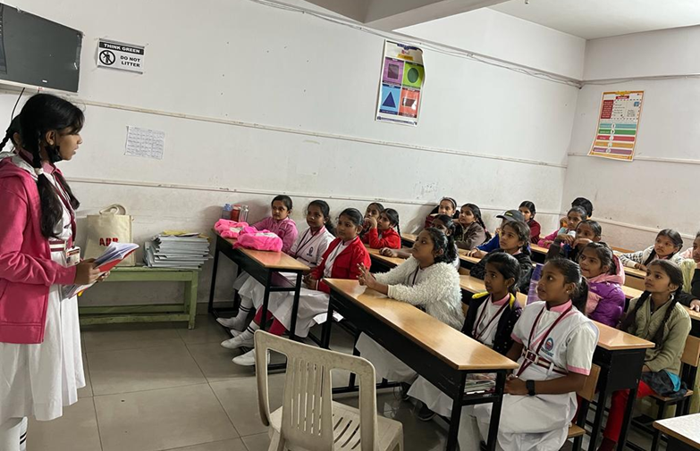
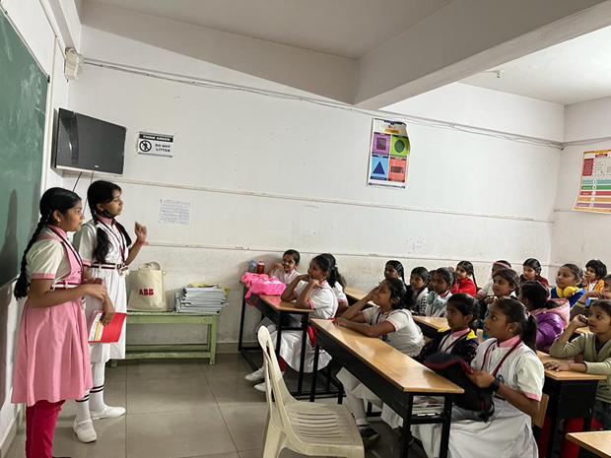
Conducted a second awareness campaign in the classes where more waste generation was found.

Slide 16
Some of the measures I found followed by our school to go paperless
1. Communication with the parents is through Whatsapp groups. Even circulars are sent as soft copy
Activities given as school assignments should be written in a book. No more printouts or downloads.
Previous years’ half written books are allowed as rough notes.
Reduced the number of notebooks issued. In the previous years we used to have unwritten note books after a year and again we had to buy books. Now, that wastage is stopped. We have correct number of notebooks so that nothing goes waste.

Slide 17
Conclusion
Though any institution takes up any measure, individual’s cooperation matters.
Even a first std student or an LKG student can make a change and help saving the environment in whatever little way they can.
For any good work to happen, frequent awareness campaigns are required.
I thought this is the right platform to communicate with the students of various schools so that all together can make a difference.

Slide 18
Acknowledgement
I sincerely thank all the students, teachers, especially Pushpa madam and Principal of my school for cooperating and helping me complete this project. My sincere thanks to the team of CES, IISC for giving me an opportunity to make my presentation.

Slide 19
References
Everything You Need to Know About Paper Recycling
https://earth911.com
How Paper is Recycled: Step-by-Step Process (and Benefits ...
https://www.conserve-energy-future.com
Paper Waste Facts - The World Counts
https://www.theworldcounts.com
How to Recycle Paper the Right Way! - Going Zero Waste
https://www.goingzerowaste.com
www.maspsofindia.com
https://baleforce.com

Slide 20
Thank You
Ameena Kousar- VII Std
Hamsika - VII std

